Slide 1
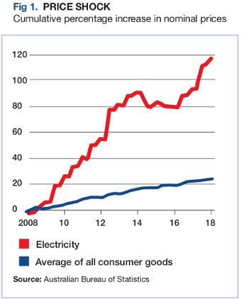
Global Warming or Cooling?
Facts about the temperature trend of the earth's atmosphere and other related matters of concern.
By: Kevin A. Loughrey LtCol(Ret'd)
BE Mech (hons), psc, jssc
Credit to Mr Tony Heller BSc Geology, Arizona State University
Masters Electrical Engineering, Rice University
Northern Arizona University Computer Science
Colorado State University Computer Science
University of New Mexico Geochemistry
Dated: 13 April 2021
Notes:
Presentation Banner

Slide 2
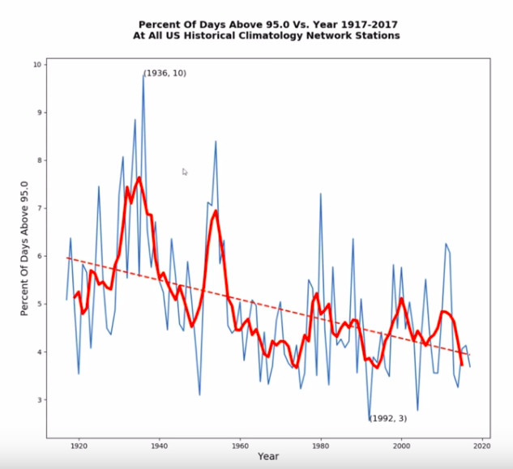
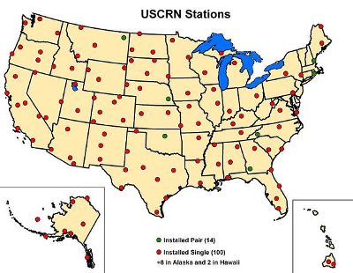
Unadjusted Data - US Climatology Network (1910 - 2018)
Average trend downwards
for 108 years
Notes:
At the core of all “Green energy” initiatives lies the false belief that human emissions are causing warming of the earth's atmosphere. It used to be called Anthropogenic Global Warming (AGW) but this name was dropped for the nebulous one of “Climate Change”.
BUT WHAT IF THE EARTH'S ATMOSPHERE WERE NOT WARMING BUT COOLING INSTEAD?
Here is a graph showing the percentage of days per annum all physical weather stations on the US Climatology network recorded a temperature over 95F.
NOTE THERE HAS BEEN A STEADY, OSCILLATING, DOWNWARDS TREND FOR OVER 100 YEARS.

Slide 3
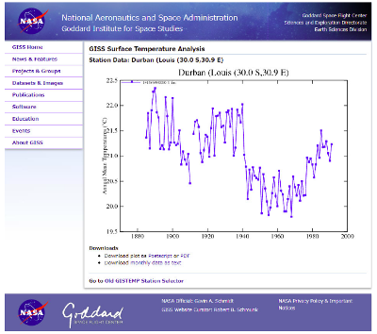
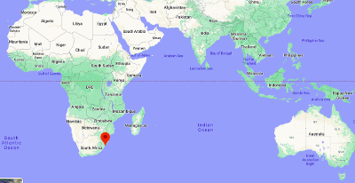
Unadjusted Data – Durban Sth Africa (1885-1995)
Average trend downwards
for 110 years
Notes:
Deniers of this fact could possibly claim that this was false or was not typical of the whole world so let's test that possibility.
Here is a similar plot, for Durban South Africa over a period of 110 years.
IT IS A DOWNWARDS TREND!

Slide 4
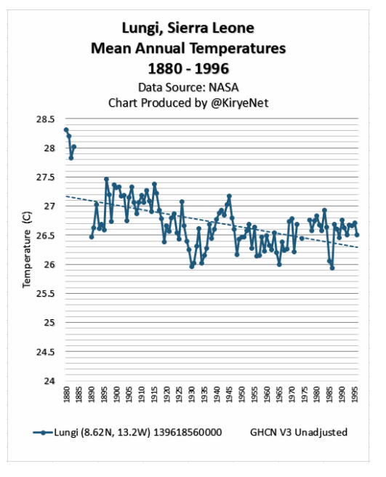
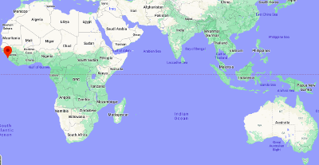
Unadjusted Data – Sierra Leone (1885-1995)
Average trend downwards
for 110 years
Notes:
Likewise on the other side of the equator, Sierra Leone shows a downwards trend for 110 years.

Slide 5
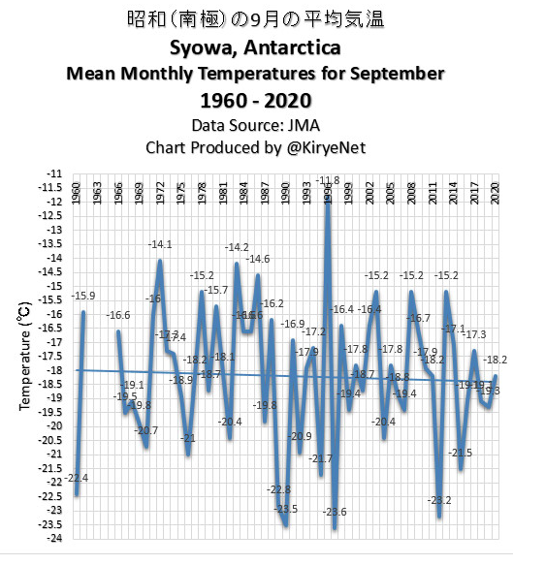
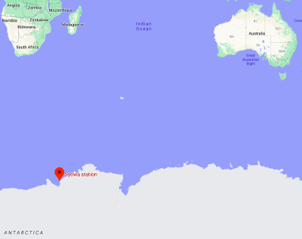
Unadjusted Data – Syowa Antactica (1960-2020)
Average trend downwards
for 60 years
Notes:
Heading to the deep South, Antarctica, we see a downwards trend for 60 years.

Slide 6
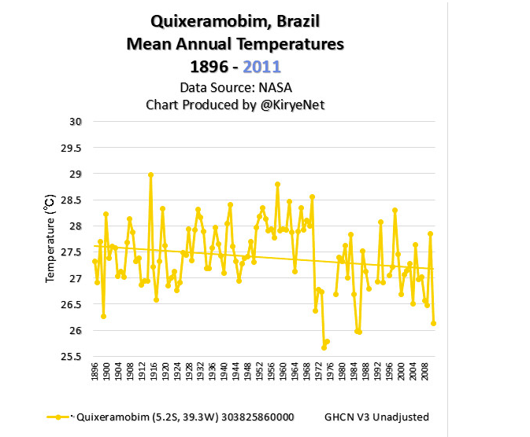
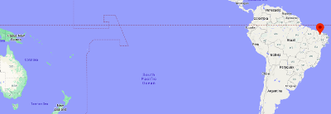
Unadjusted Data – Quixeramobim Brazil (1896-2009)
Average trend downwards
for 113 years
Notes:
Over to Brazil near the equator.
A downwards trend for 113 years.

Slide 7
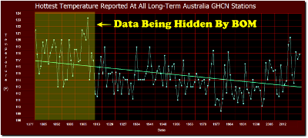
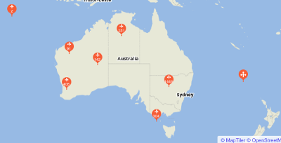
Unadjusted & Adjusted Data – Australia (1877-2016)
Average trend downwards
for 139 years
Data taken from “long term” weather stations
As @March 2021 BoM Map indicates there are 2,641 stations
Notes:
And here we have Australia with the longest records going back 139 years.
A downwards trend, mimicking the US plot until Jim Hansen made his presentation to Congress in 1988.
Suddenly the temperatures started to rise.
Why was that?

Slide 8
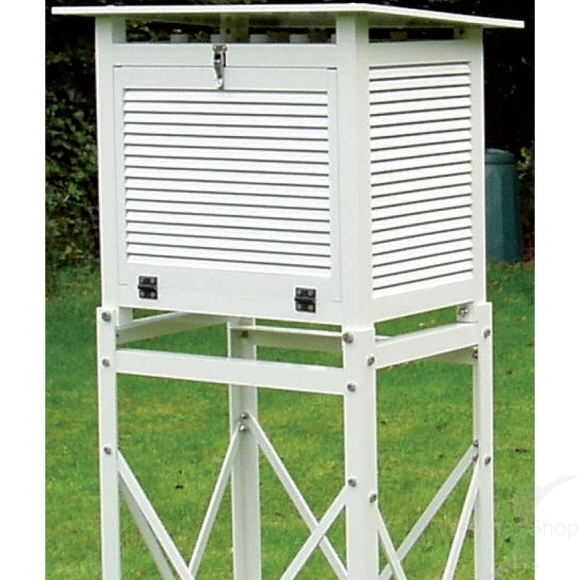
Replaced Large Stevenson Screens for Smaller Ones and analogue for digital without running in parallel to calibrate
Notes:
The Australian Bureau of Meteorology modernised its network by installing new Stevenson Screens but they installed smaller ones which are known to record higher temperatures.
They did not run the old equipment in parallel with the new ones; something Dr Jennifer Marohasy has been trying to get them to do for some years now!
Similarly, they installed digital measuring systems, replacing the analogue. Once again, they did not run these systems in parallel for a meaningful period of time, ie, 5 years to calibrate old temperatures with new.
The digital equipment was configured so that it would not record temperatures below -10C. This fault has now been rectified.

Slide 9
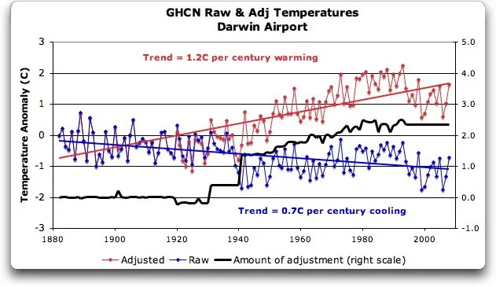
Homogenisation consistently raises the temperature
Notes:
The Australian Bureau of Meteorology, when migrating the handwritten records to their computer database did not faithfully transcribe all records. Some very hot temperatures were omitted. (Discovered by Mr Craig Kelly MP)
They then carried out a process in collaboration with the US National Oceanic and Atmospheric Administration (NOAA – custodians of the Global Historical Climate Network, GHCN, records) to “homogenise” the data in the temperature records.
I have reviewed their stated reasons for doing this and find that, empirically and in science, they have no merit.
The end result is to feed into the global warming narrative when all raw data from around the world indicates a global cooling trend over the last 100+ years.

Slide 10
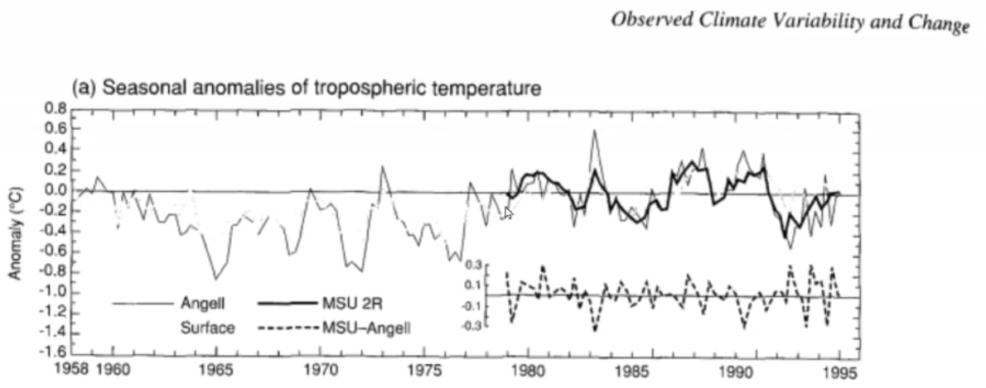
Weather Balloon&Satellite and Surface Data 1958-1995
Notes:
This graph shows results obtained from weather balloons and then superimposed over this in the latter stages is Satellite data. The dotted line graph shows surface temperature data up to 1995.
During this period, overall there has been little change and various oscillations are evident.

Slide 11
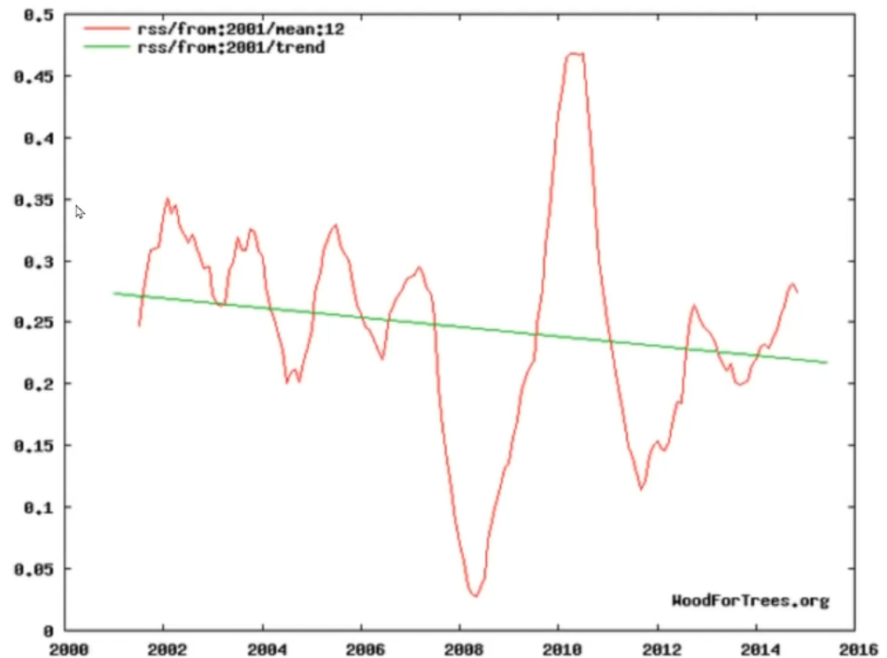
Raw RSS (Remote Sensing Systems) Satellite Data 2000-2016
Notes:
This is the raw data from the RSS feed of a temperature measuring satellite.
Other feeds from other satellite data (University of Alabama and Huntsville – UAH) show warming. There is obviously a disagreement in satellite measurements.

Slide 12
“Climategate” emails showed scientists were forging data
Notes:
This is an excerpt from emails that have come to be known as “Climategate”. It is from Kevin Trenberth who worked at the National Centre for Atmospheric Research. Here Trenberth is lamenting the fact that the data shows cooling, not warming.

Slide 13
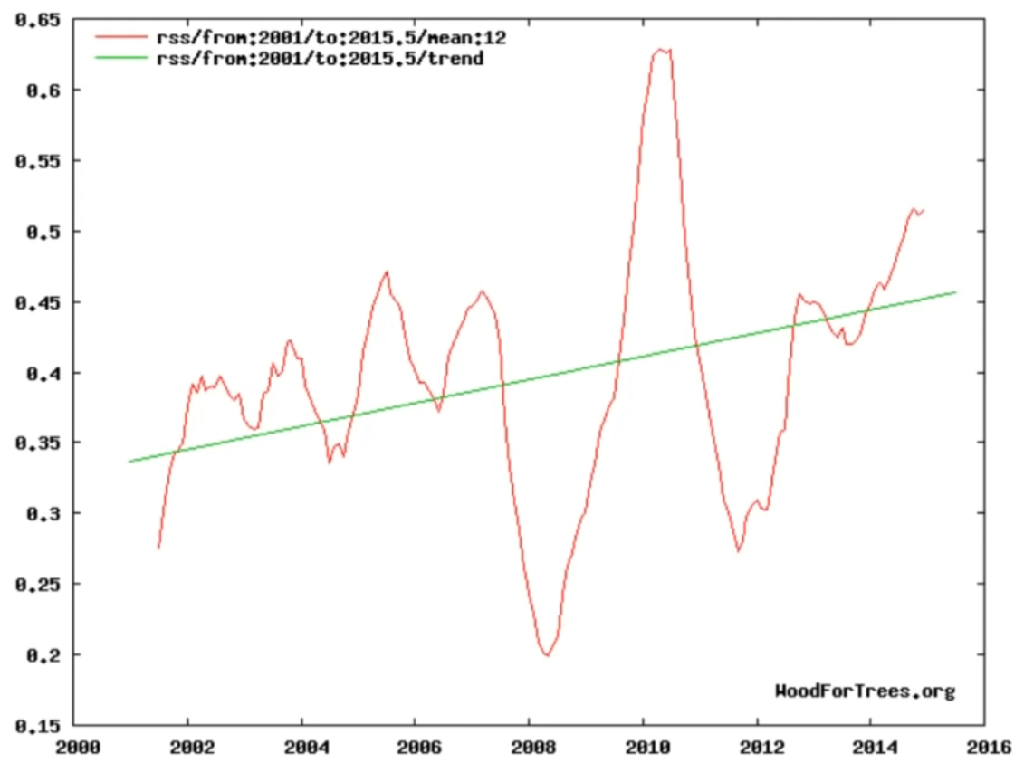
Fraudulent changing of raw data to show warming
Notes:
So, no worry, we'll just change the data. No one will notice. Not the least the stupid insipid media.

Slide 14
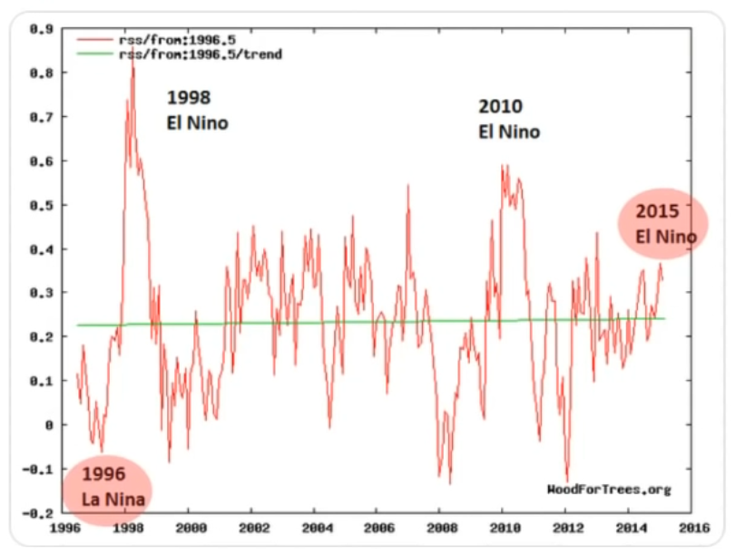
This RSS unadjusted data shows the effect of El Ninos
Notes:
This graph was used by Senator Ted Cruz to show that there was no warming of the earth's atmosphere. It cause quite a stir. What is interesting is that it shows the effect that El Ninos have on the earth's atmospheric temperatures. You can see that each peak is getting noticeably less and less.

Slide 15
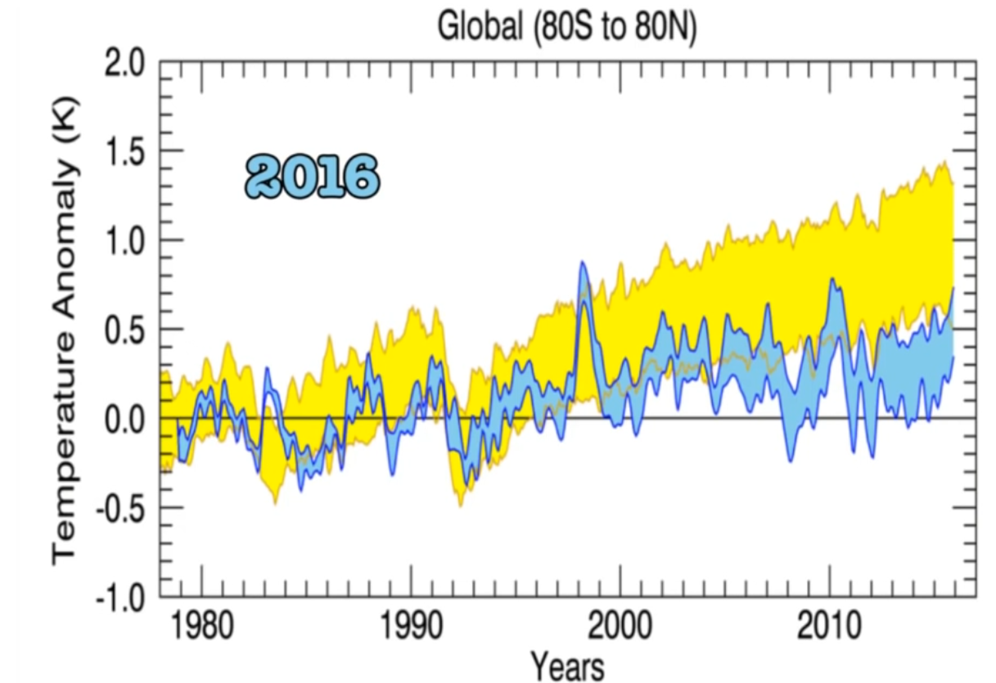
This is a graph presented by Carl Mears in 2016
Notes:
This is a graph presented by Carl Mears a scientist working at Remote Sensing Systems from 1998. Note that the blue plot shows actual data with an error band and the yellow shows what computer models predicted. There is a very poor correlation and, if anything, the trend is downwards since 2000.

Slide 16
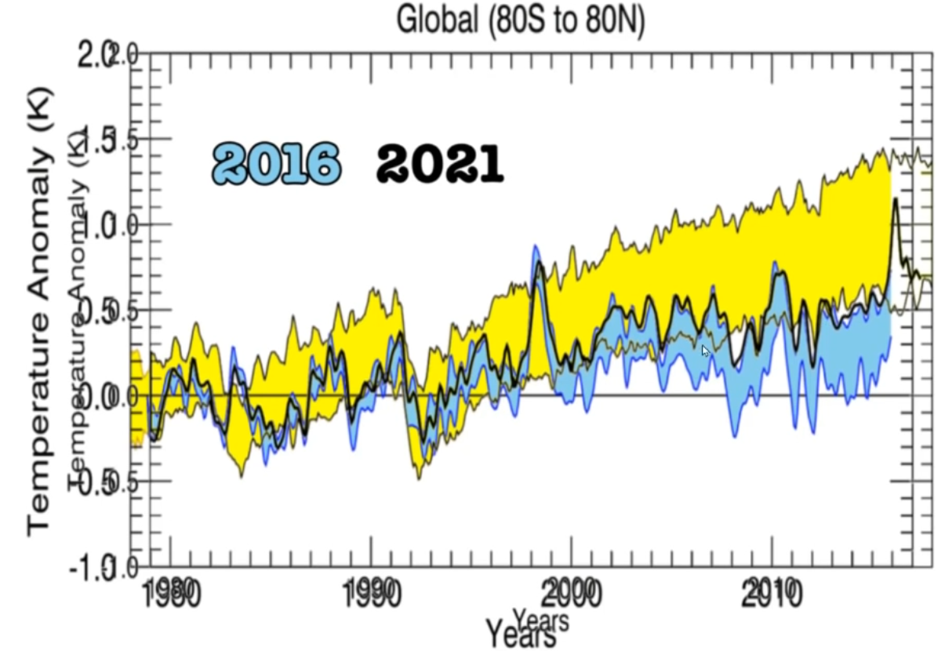
This is a graph altered by Carl Mears in 2016
Notes:
Because of pressure applied by the climate mafia, Carl Mears simply got rid of the error band and showed only the upper limits; the black line.
Here are the two graphs superimposed in each other.
This is blatant fraud and it has cost the world trillions of dollars. It has damaged Western economies and it has assisted Communist China in its quest to be the most dominant power in the world.

Slide 17
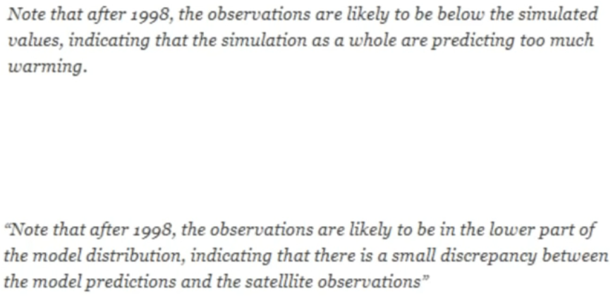
Changed wording to accord with changed method of presentation
Notes:
And then Carl Mears changed his wording. Now instead of the models predicting too much warming, it says that the data shows it is in the lower band of the model predictions.

Slide 18
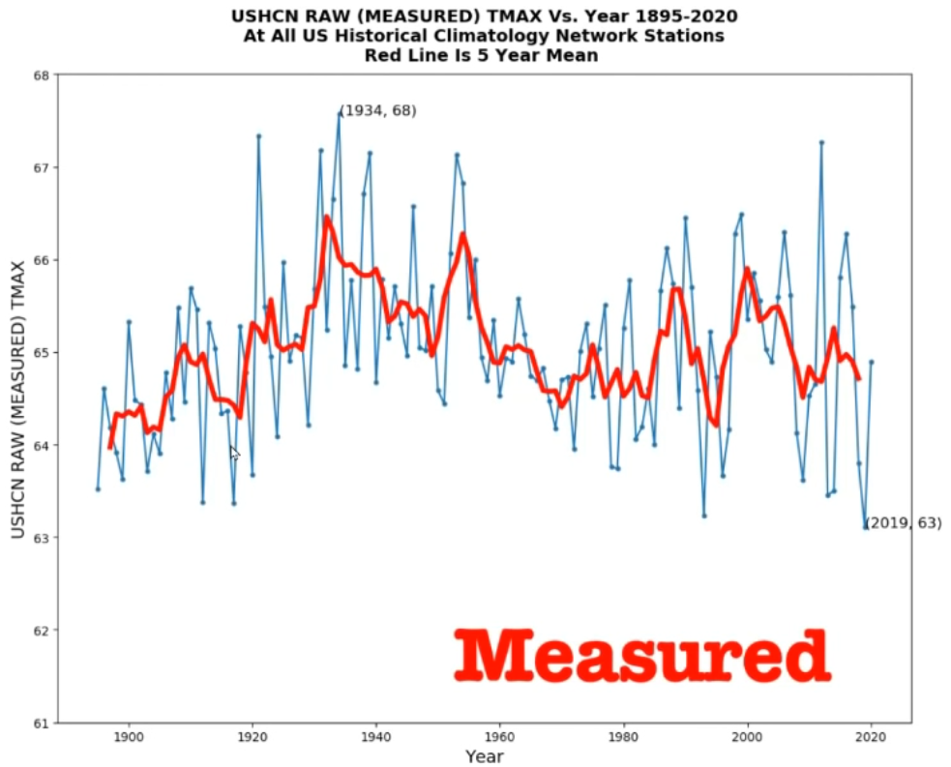
Measured Average Ground Temperatures in US
Notes:
The same manipulation of data has occurred with respect to ground temperatures.
Here is a plot of the raw data.

Slide 19
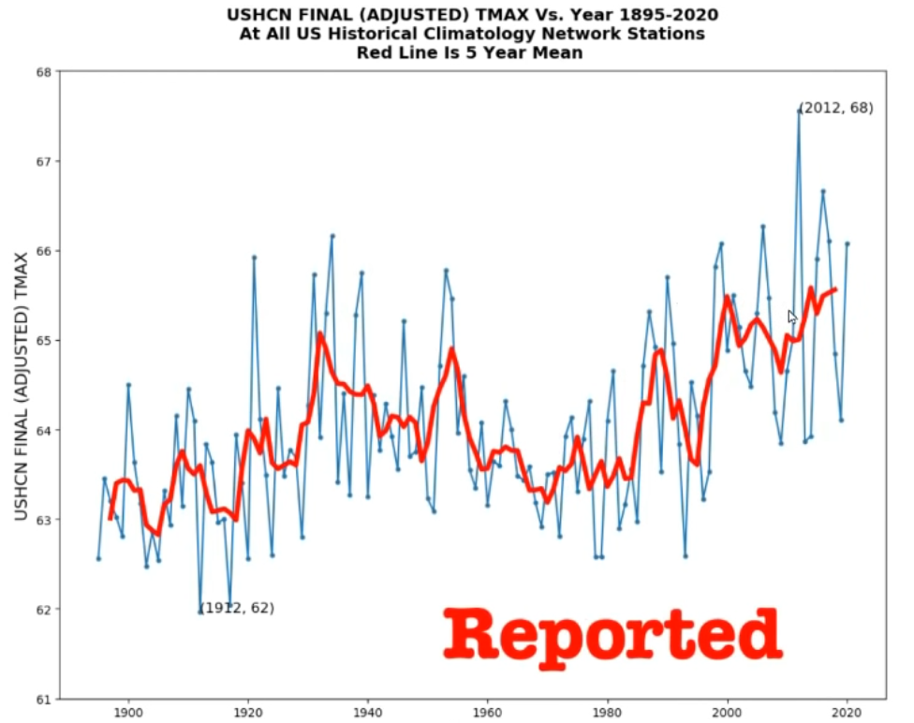
Reported (after “adjustment”) Average Ground Temperatures in US
Notes:
Here now is a plot of the adjusted data. Note how it now shows a steep warming trend.
This is blatant fraud!

Slide 20
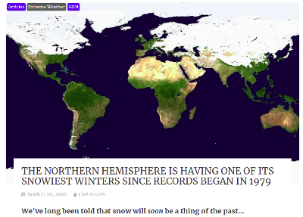
The future looks a lot cooler!
Notes:
This is what is really happening.
In 2020-2021 the Northern Hemisphere had one of its snowiest winters since records began in 1979

Slide 21
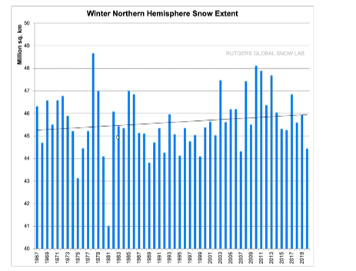
Northern Hemisphere Snow Extent (1967-2020) has been increasing
Notes:
Here is a plot of Northern Hemisphere Snow Extent dating back to 1967. As to be expected, with a cooling climate, it shows an upward trend.

Slide 22
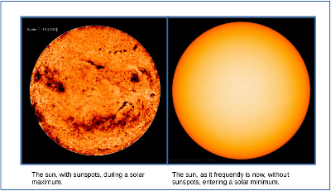
The Sun has gone Blank
Notes:
Why should this be happening?
The sun has been routinely blank for over 2 years now.
The sun's magnetic field is collapsing. This happens every 340+ years; the last event being the Maunder Minimum.
When the magnetic field collapses, the sun's radiation output reduces but, possibly more importantly, a greater flux of cosmic rays can enter the solar system and, as a result, more cosmic rays impact the earth's atmosphere. These cause cloudiness in the upper atmosphere and this reflects the sun's radiation making the earth cooler still.

Slide 23
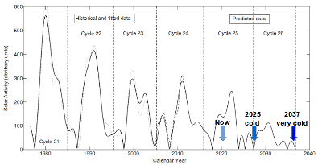
Sun's strength is decreasing and will continue to do so
Notes:
This graph depicts sunspot activity and sun's 11 year cycle.
You can see where we are at this point and what lies ahead.
It is going to become quite cold around 2025 and colder still by 2035!

Slide 24
$1.3 Trillion Government Debt wasting huge amounts of money & crippling industry.
There is a cost of $14 billion per year
incurred by consumers and
taxpayers, or a
total cost of $140 billion over 10 years.
Already 10 coal fired baseload
power stations have closed in Australia.
With $140 billion, the Australian Taxpayer could have built
70 coal fired power stations!
Notes:
This slide says it all.
The Australian Government has wasted over $140 billion dollars on renewables.
Much of this money has gone to the Chinese Communist Party purchasing solar panels and windmill components.
High electricity prices make Australia's industries less competitive and do great harm to the most vulnerable in our society.
All of this based on the false belief that CO2 emissions must be curbed for the good of the planet.

Slide 25
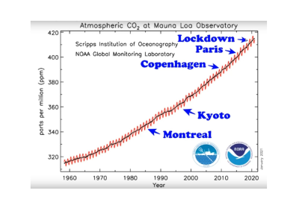
Atmospheric Carbon Dioxide Concentration
is not affected by policies or by the COVID 2020 shutdown of industry
Notes:
In this graph you can see that nothing mankind has done up to this point has made the slightest difference to the rising concentration of CO2 in the earth's atmosphere.
Note especially that during the 2020 lockdown of industry CO2 levels continued to rise.

Slide 26
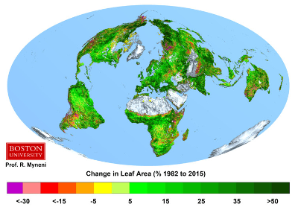
Atmospheric Carbon Dioxide Concentration
is analogous to a queue. CO2 Molecules arrive and molecules are processed.
The rate of processing has grown by many times that of mankind's total emissions!
Notes:
Satellites reveal that the earth has become greener. By this they mean that the green leaf area has increased.
For the same daylight hours of sunlight, CO2 ingestion by plants is proportional to leaf area.
CO2 ingestion has therefore grown over the last 50 years by somewhere between 8% and 16% yet the output of human emissions is around 4% of the total CO2 being emitted to the atmosphere.
In other words, on land alone, not counting what is happening in the oceans (the main provider of oxygen to this planet), the rate of ingestion has grown by a number of times that of mankind's output yet the CO2 concentration continues to increase. Put simply:
MANKIND'S EMISSIONS ARE NOT RESPONSIBLE FOR INCREASING ATMOSPHERIC CO2!

Slide 27
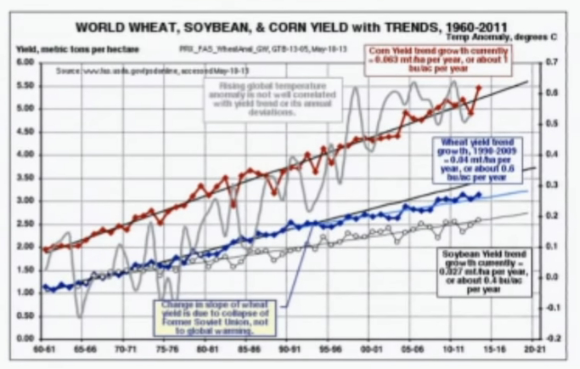
The effect of increased CO2 – Crop Yields
Notes:
Increasing CO2 allows plants to grow in drier climates.
This has resulted in deserts (which take up 1/3rd of the earth's surface) receding.
It has also resulted in increased crop yields of all cereal crops.
Without this increase in cereal crop productivity, it is likely there would have been famine in some parts of the world.

Slide 28
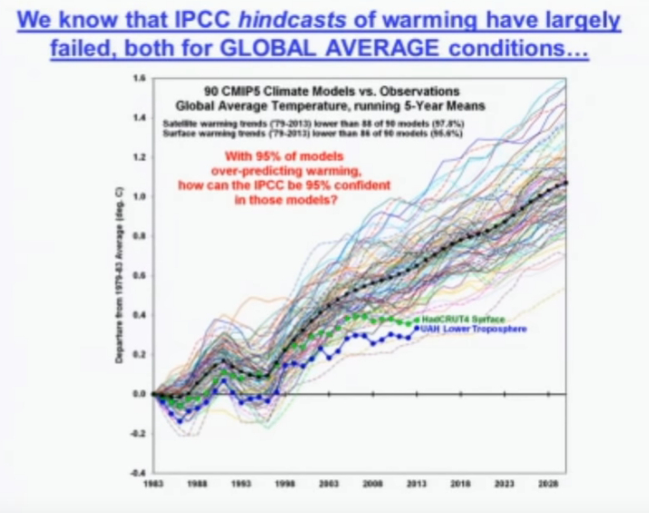
The Climate Crisis?
Notes:
All climate predictions using computer models have greatly exaggerated the warming and are wildly inaccurate.
This has affected the “adjusted” temperature data being used for the Global Historical Climate Network managed by NOAA because these same inaccurate computer models were used to create the data for what are called “zombie” weather stations.

Slide 29
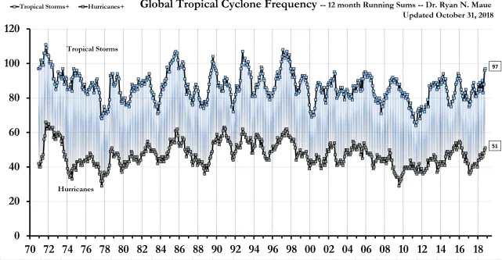
The severity of Cyclones & Hurricanes – decreasing over 4 decades
Notes:
Continuing on with the hysterical theme the world is in a climate crisis, it can be seen from this data that the severity of Cyclones and Hurricanes is slowly declining.

Slide 30
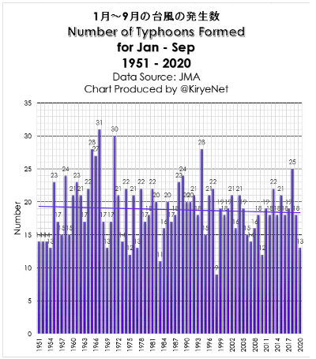
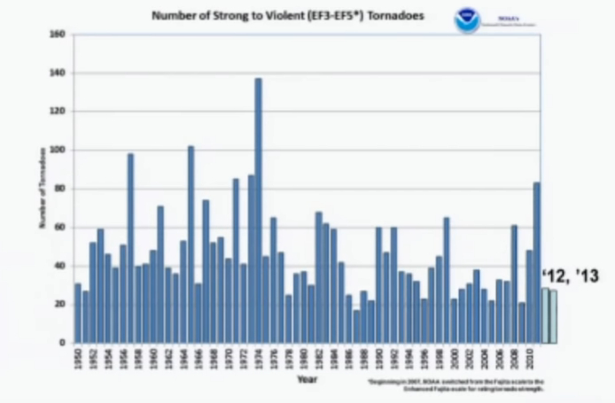
The Typhoons & Tornadoes – Decreasing Severity
Tornadoes 1950-2010
Notes:
Likewise Cyclones and Hurricanes, Typhoons and Tornadoes have been steadily decreasing.

Slide 31
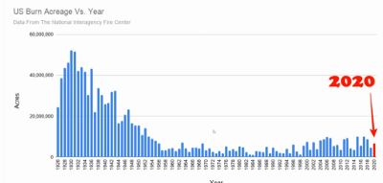
Burned Acreage in US – 1926 to 2020 – significant decrease
Notes:
In the US and in Australia, burn acreage has decreased since the 19th Century.

Slide 32
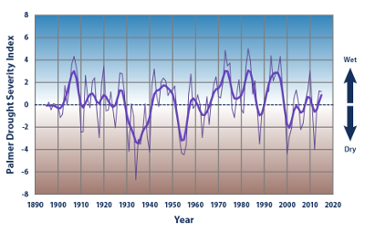
Drought severity in US – Improved wet from 1955 to 2020
Notes:
The situation with droughts in the US is that the climate has become wetter from around 1955 to the present day.
With a cooling climate though, once the oceans have cooled, it is expected that the climate could become drier.

Slide 33
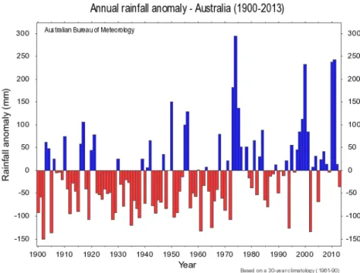
Drought severity in Australia – Improved wet from 1972 to 2010
Notes:
Australia shows some similarity with the US in that it became wetter around 1970 but by 2010, it started to become drier again
As mentioned previously, once the oceans have cooled, it is expected that the climate could become drier due to less evaporation.
It is essential that Australia build dams and responsibly divert water from places where it is plentiful to places where it is not in case this happens. Regardless, such diversion can only do a great deal of good and provide a greater level of certainty for Australia's farmers.

Slide 34
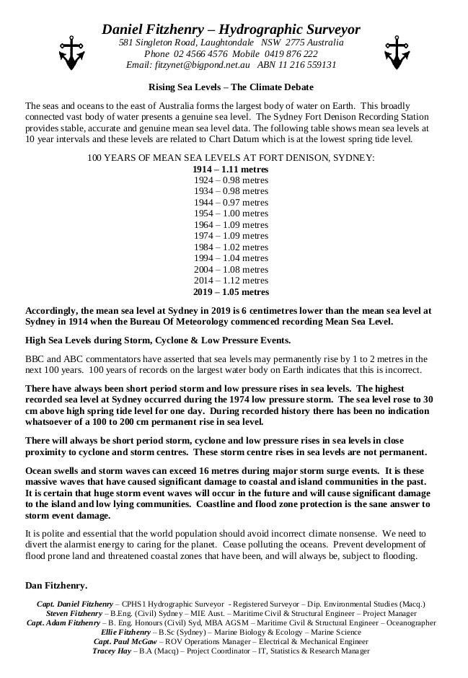
Sea Levels
Notes:
According to this study done by Capt Daniel Fitzhenry, when tide gauge vertical movement, barometric pressure and planetary positions are taken into account, the Pacific Ocean has dropped by about 60 mm since 1914.

Slide 35
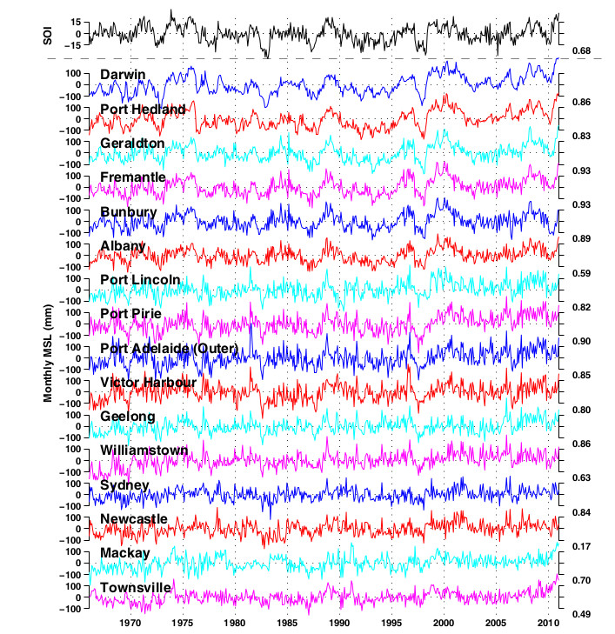
Australian Tide Gauge Data - no real movement of the seas
Notes:
Tide gauges confirm that sea levels around Australia are not rising rapidly. The graphs shown here do not take into account possible vertical movement of the gauges over time, the influence of the gravitational pull of planets and the barometric pressure at the time of reading.
These graphs suggest that it may well be that Capt Daniel Fitzhenry is correct when he says that the Pacific Ocean has dropped by around 60 mm since 1914.

Slide 36
HOW TO FIX THIS?
1. Educate the Young. At this moment schools in all States are teaching bad science when it comes to what is happening to Australia's and the World's climate.
2. End all subsidisation of “renewables”.
3. Take all statutory action to allow nuclear research and the nuclear industry, in all its forms, to flourish in this country.
4. Collocate modular nuclear reactors at existing coal fired power stations. This would greatly speed up implementation, significantly reduce the cost of implementation and dramatically reduce the cost of electricity in this country.
Notes:
There is an urgent need for Government to commence a systematic campaign of education so as to debunk the present global warming scam.
In concert with this, there is a need to remove all subsidies from so-called “renewables”.
This country must allow nuclear research and the harnessing of nuclear power.
Collocating nuclear reactors with existing coal fired power stations provides an inexpensive, speedy and convenient means of transitioning to nuclear power.

